Slide 1
Nevada Transportation Conference Project Manager: Dallan Affleck, P.E. Jim Mischler, PE (CA Group)
5/6/2024

Slide 2
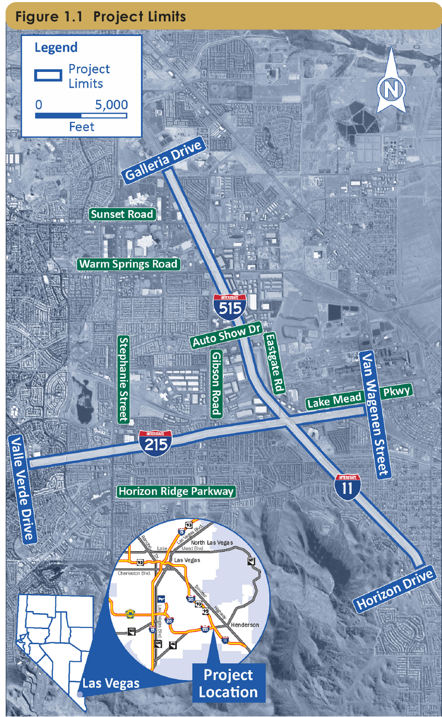
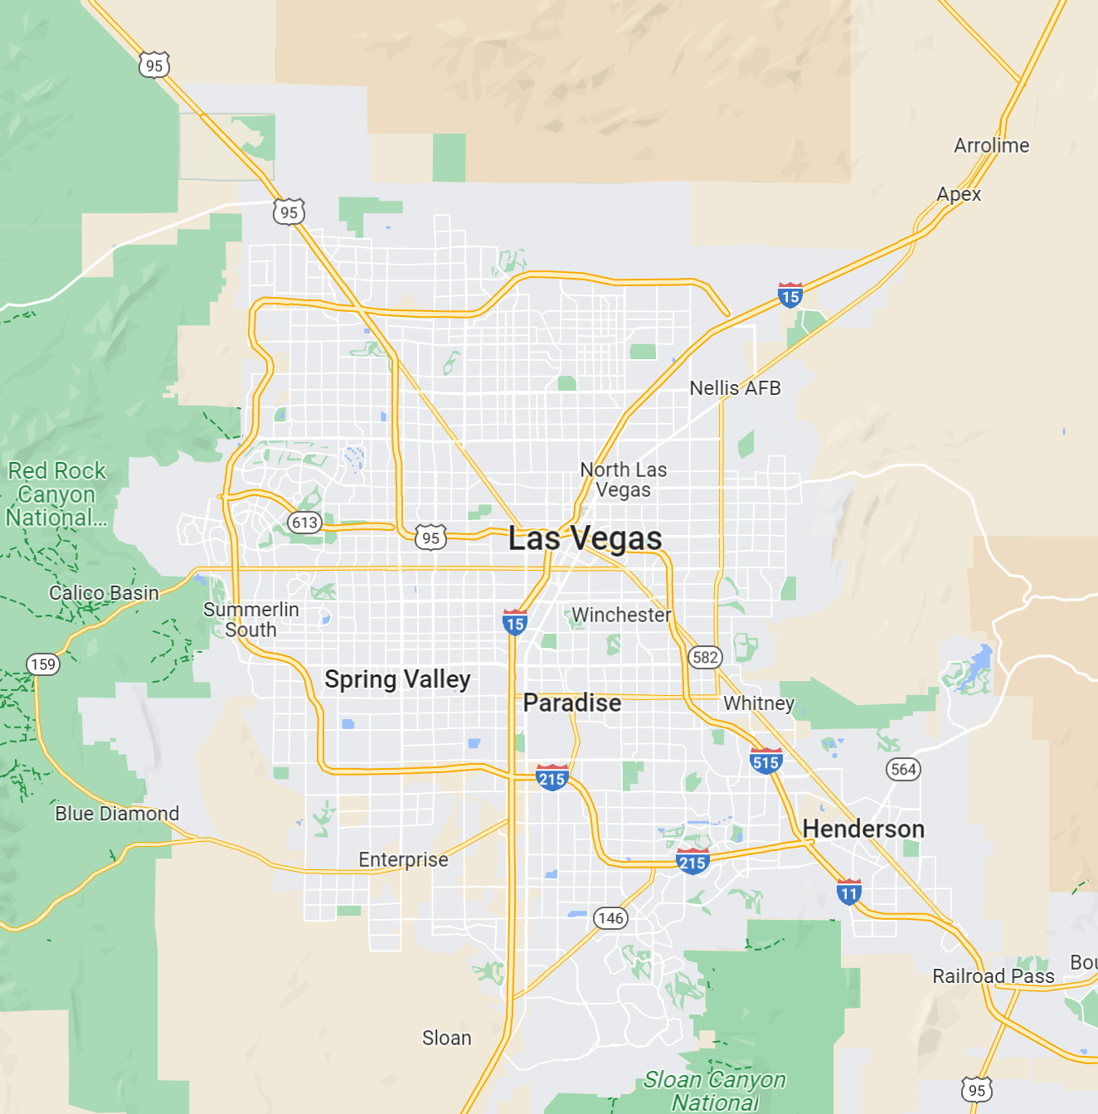
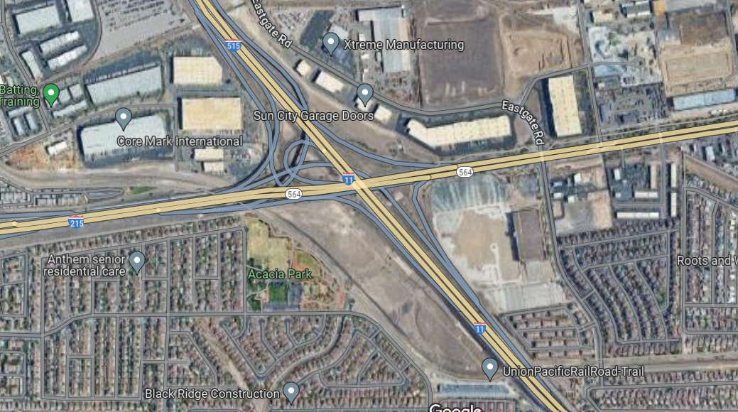
Henderson Interchange I-11 / I-515 / I-215 / Lake Mead Parkway

Slide 3
Regional Projects
NEPA limits from I-215 at Valle Verde to Lake Mead Parkway at Van Wagenen (City of Henderson I-215 Widening project will improve west of Stephanie Street)
NEPA limits from I-11 at Horizon Drive to I-515 at Galleria Drive (NDOT 3-R project will improve north of Sunset Road)
I-11 Designation – Sign Conversion

Slide 4
I-215 Widening - Pecos Rd. to Stephanie St. City of Henderson
Funded by CCPW
Administered by COH.
NDOT has maintenance of this section of the I-215
Improvements
I-215 - Widening - 3 to 5 lanes plus auxiliary lanes.
Pecos Road./St. Rose Pkwy. - Interchange and arterial improvements
Ramp Reconstruction - Valle Verde Dr. & Stephanie St.
Green Valley Pkwy. – DDI & arterial improvements.
Construction Summer 2024.

Slide 5
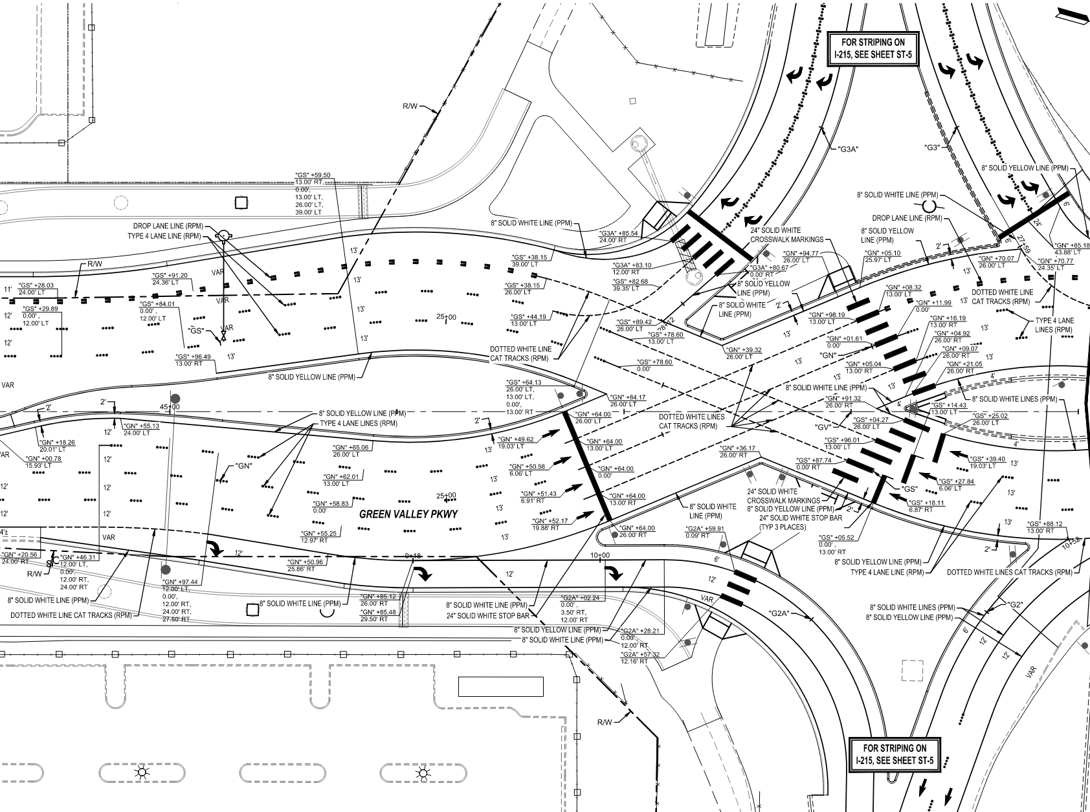
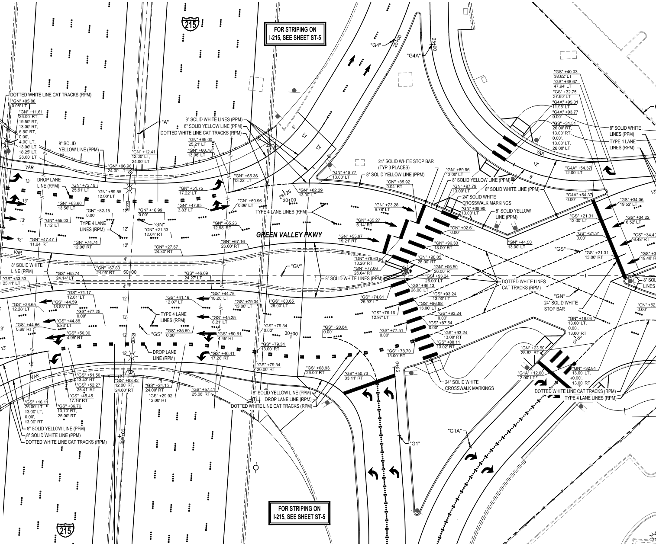
DDI at Green Valley Parkway. I-215 Widening - Pecos Rd. to Stephanie St.

Slide 6
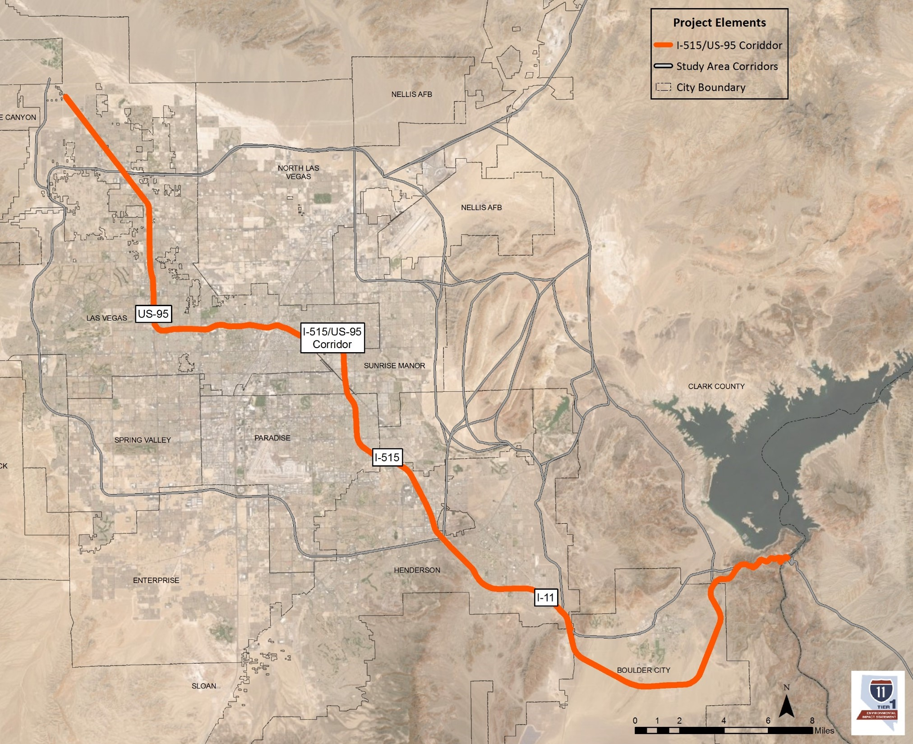
I-11 Designation Update
PEL Study 2023
Alternative I-11 routs
Selected (US-95 / I-515).
FHWA Approval 1/2024
This rout is nearly at interstate standards – Improvements limited to
Sign updates coordinated with current construction projects.
Signage conversion to show I-11
The project is advertising this month.

Slide 7
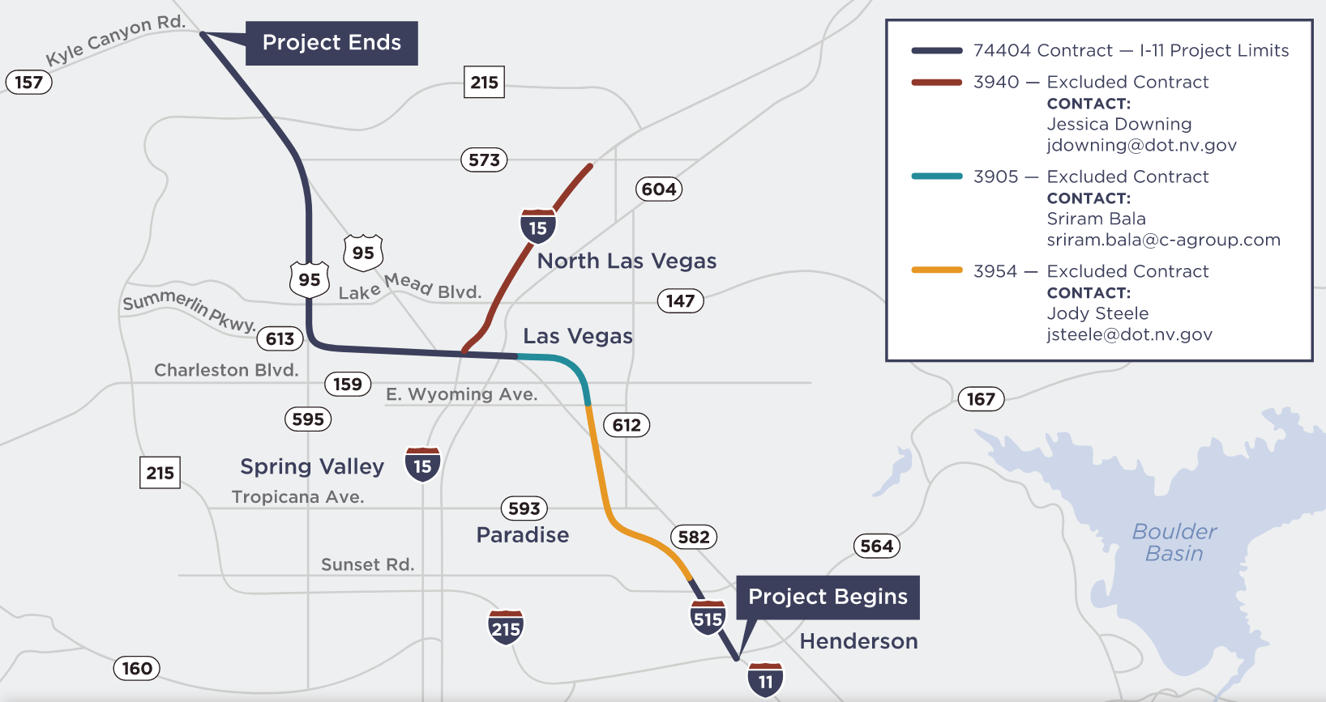

Slide 8
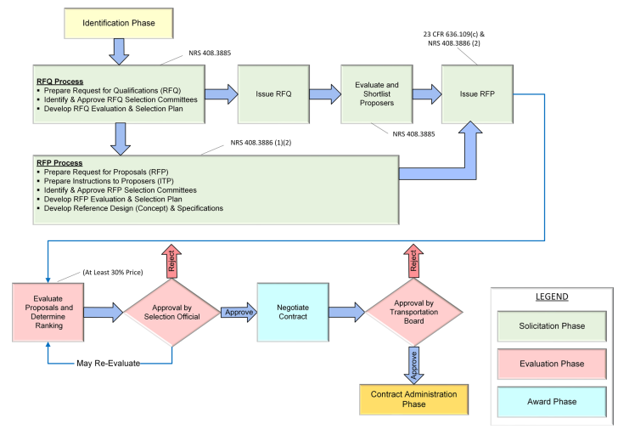
Procurement Process
RFQ*
Statement of Qualifications*
Shortlist/RFP*
Proposal*
Selection
*Complete
Design Builders develop Alternative Technical Concepts and their proposals

Slide 9
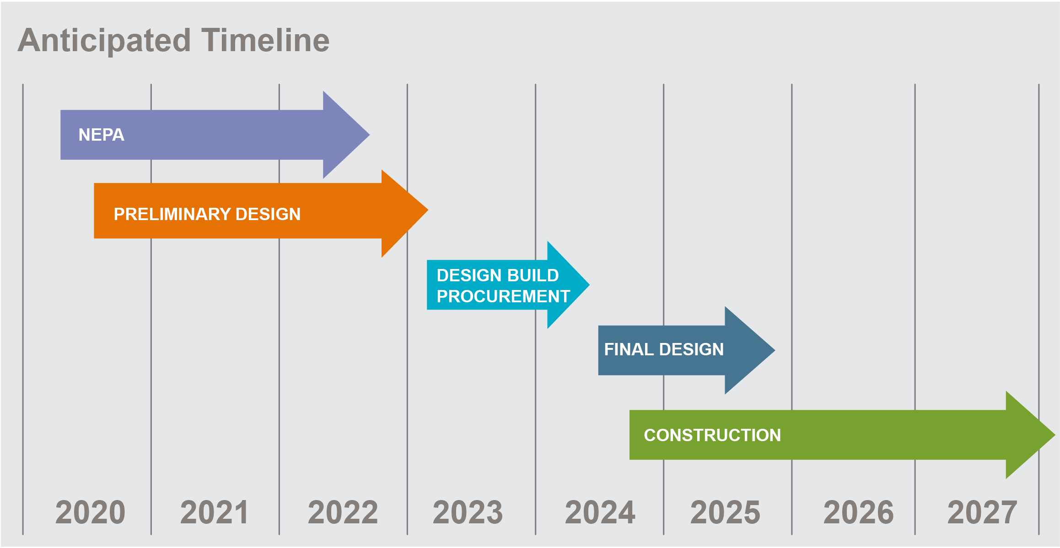
Henderson Interchange Schedule
RFQ: Early April 2023
Shortlist: July 2023
Draft RFP: July 2023
Final RFP: Sept 2023
Proposals Received: Apr 2024
Selection: Jun 2024
Contract Award: Jul 2023
NTP 1: Late Summer 2024
Design & Construction 2024-2029

Slide 10
I-11/I-515/CC-215 Henderson Interchange
3 Proposals Recently Received from the Shortlist
Kiewit Infrastructure West
Ames Construction
Fisher Sand and Gravel
Notes:
Innovative crossover style provides a directional interchange with fewer and smaller structures than traditional directional interchange
- Braided ramps are used to reconnect Gibson Road and Auto Show Drive following access changes put in place with the recent restriping project
Auxiliary lanes between Horizon Drive and the system interchange will protect I-11 traffic from local roadway queuing
27 Bridges within the project footprint. 20 bridges will be maintained or widened, and 6 demolished. 12 New bridges will be constructed.
Adds capacity to meet needs of projected 2040 traffic volume
Restores access to Gibson Road with braided ramps. Restores and adds access to and from Auto Show Drive with braided ramps.

Slide 11
Reference Design

Slide 12
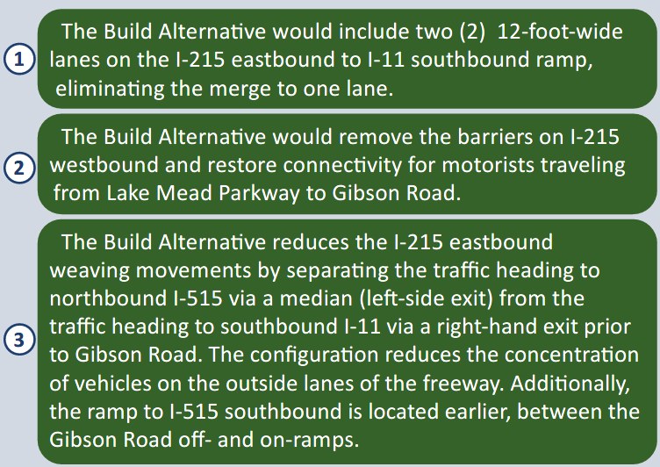
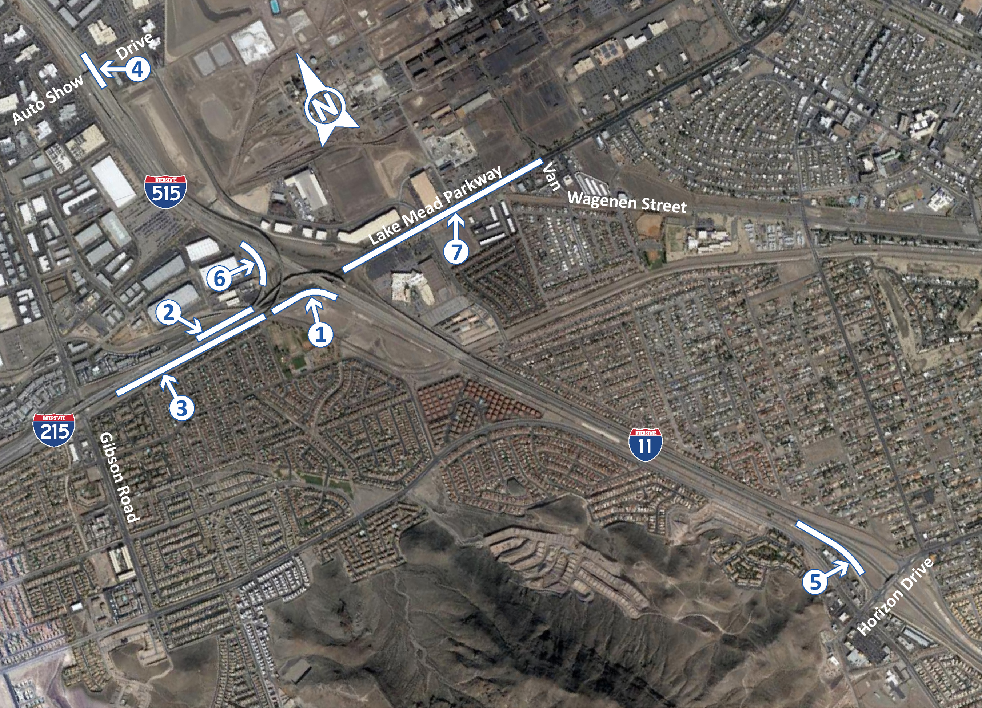
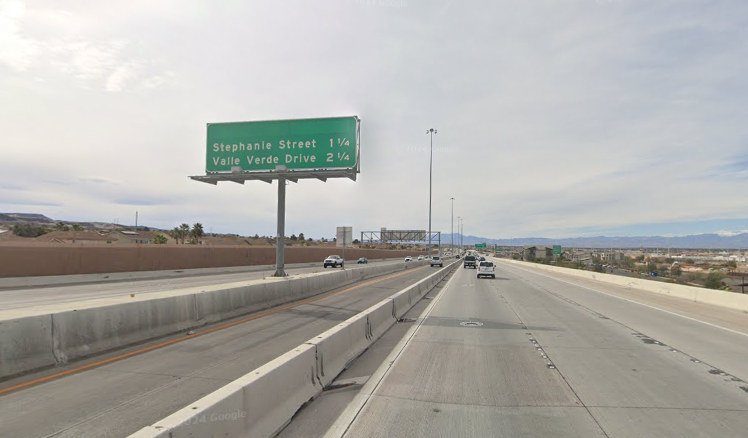
How Needs are Met

Slide 13
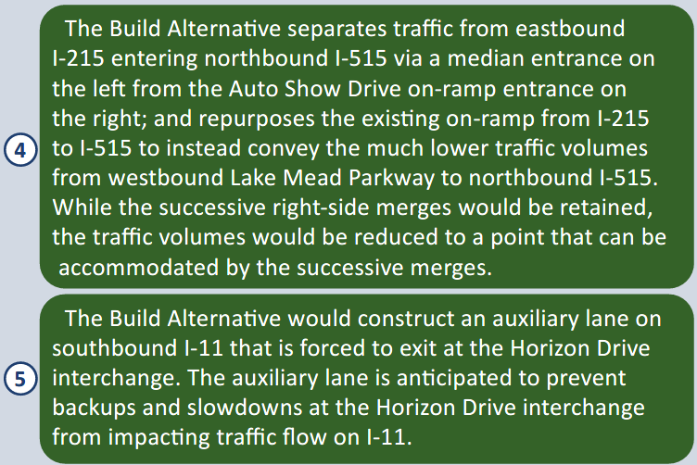
How Needs are Met

Slide 14
How Needs are Met

Slide 15
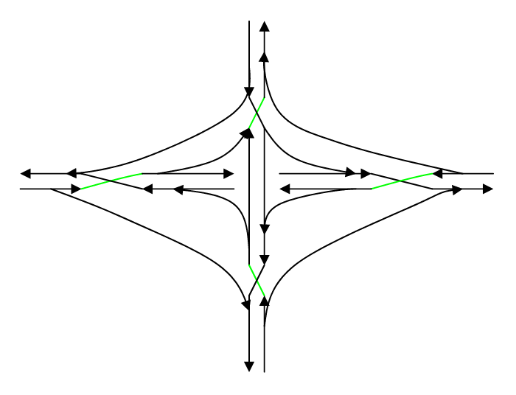
Crossover Configuration
Crossover style interchange provides directional ramp connections with as few as five bridges.
Previous applications in Birmingham and near Baltimore served as Gil Chlewicki’s inspiration for his 2003 paper on what he coined as the “Diverging Diamond Interchange”

Slide 16
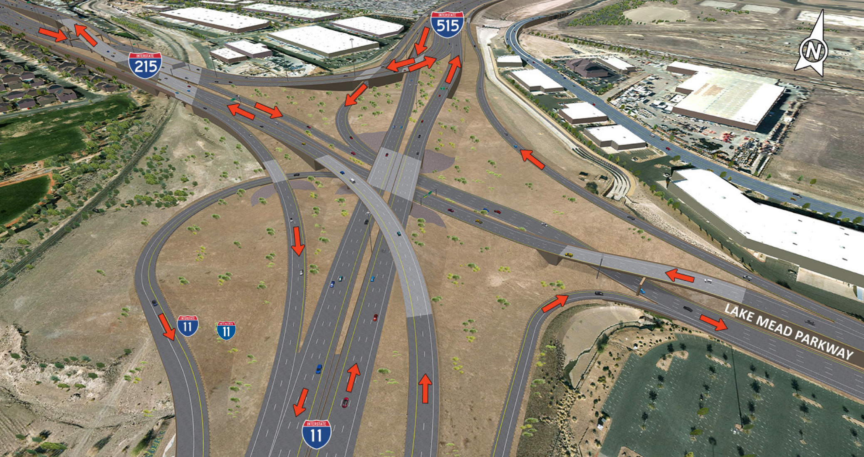
Crossover Configuration
Only the east-west
movement crosses
Proximity of west rail
complicates design
Vertical design is key
Median connector
serves I-215 & I-515
and accommodates
future HOV
Proposers may offer alternative configurations

Slide 17
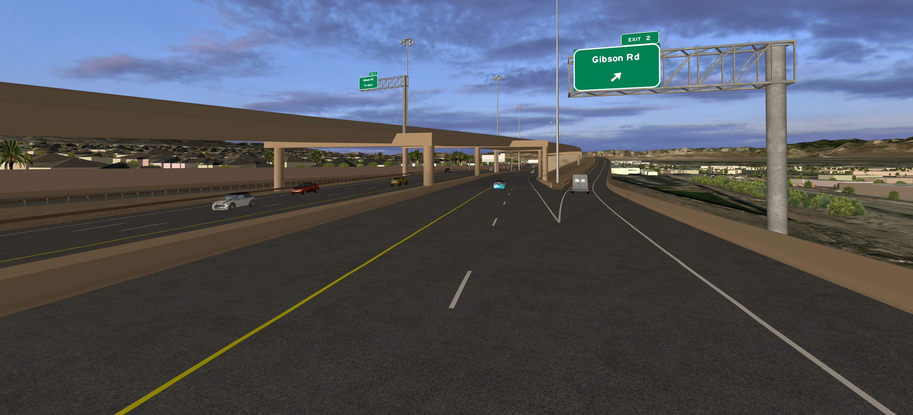
Crossover Configuration
Access from WB Lake Mead Parkway to Gibson Road using braided ramps
Portion of western crossover straddle-bent bridge visible at left

Slide 18
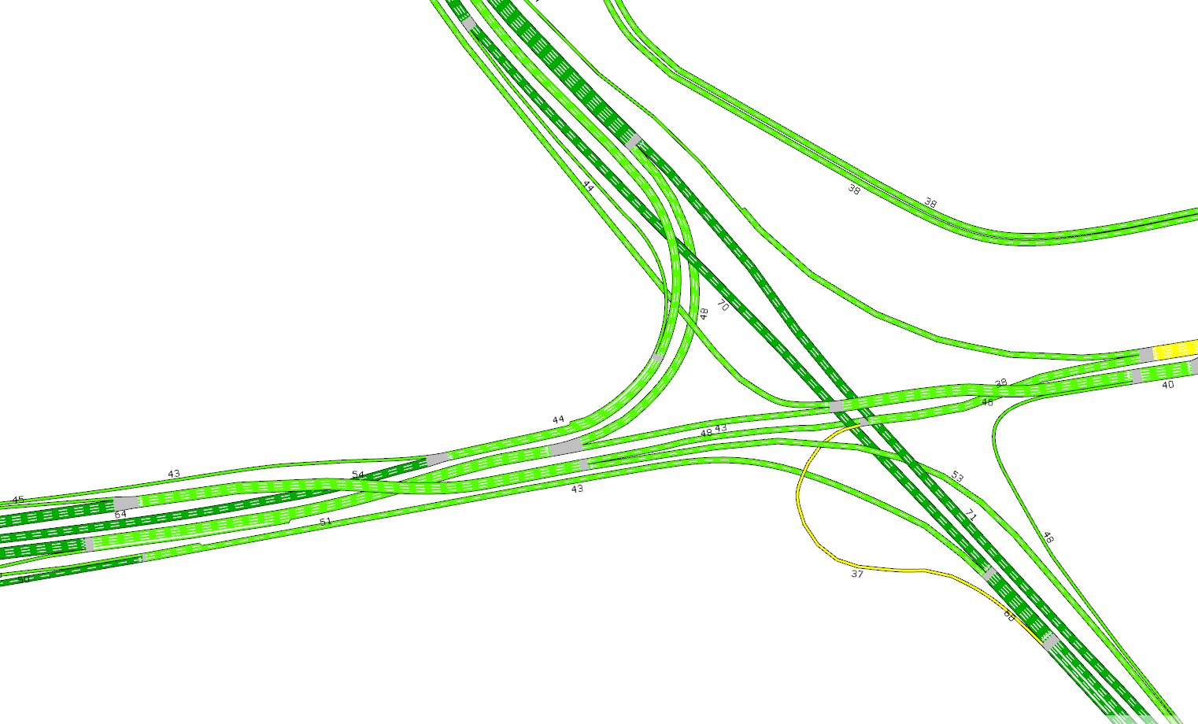
Design-Build Innovation
Interchange configuration is not prescribed, however:
Provide compliant AIMSUN NEXT model (Version 8.2.4) that adheres to TP Section 11)
Cannot result in need for a supplemental EA or EIS
Maintain access to local roads, as currently configured in Reference Design
Maintaining traffic during construction – the goal is to continue to provide the same number of lanes as currently exists
Provide the required number of traffic lanes in the constructed project
Maintain trails or provide detours that meet accessibility requirements

Slide 19
Thank you! Questions?
10/25/2023
Notes:
No notes

